Slide 1
Process Scheduling, Time and Clock

Slide 2
Process Scheduling
A process which allows one process to use the CPU while the execution of another process is on hold (in waiting state).
Whenever the CPU becomes idle, the OS (CPU scheduler) must select one of the processes in the ready queue to be executed.
CPU scheduler selects a process among the processes that are in the ready queue.
Scheduler selects processes from the queue and loads them into memory for execution.

Slide 3
Process Scheduling
A CPU scheduling algorithm tries to
Maximize
CPU utilization and
Throughput
Minimize
Waiting time,
Response time and
Turnaround Time.

Slide 4
Process Scheduling
CPU utilization
Keep CPU as busy as possible.
Throughput
The number of processes that finish their execution per unit time

Slide 5
Process Scheduling
Waiting time
The amount that specific process needs to wait in the ready queue.
Response time
The amount of time after which a process gets the CPU for the first time after entering the ready queue.
Turnaround time
The amount of time to execute a specific process.
It is the calculation of the total time spent waiting to get into the memory, waiting in the queue and, executing on the CPU.

Slide 6
Process Scheduling
Dispatcher
The dispatcher gives a process control over the CPU after it has been selected by the CPU scheduler.
The dispatcher involves in
Switching context,
Switching to user mode and
Jumping to the proper location in the user program to restart that program.
The dispatcher should be as fast as possible because it is invoked during every process switch.
The time taken by the dispatcher to stop one process and start another process is known as the Dispatch Latency.

Slide 7
Process Scheduling
Types of CPU Scheduling
Non-preemptive scheduling:
once the CPU has been allocated to a process, the process keeps the CPU until it releases the CPU either by terminating or by switching to the waiting state
Preemptive Scheduling:
the tasks are usually assigned with priorities. At times it is necessary to run a certain task that has a higher priority before another task although it is running. Therefore, the running task is interrupted for some time and resumed later when the priority task has finished its execution.

Slide 8
Scheduling Algorithms
To decide which process to execute first and which process to execute last to achieve maximum CPU utilisation, many algorithms are defined :
First Come First Serve(FCFS) Scheduling
Shortest-Job-First(SJF) Scheduling
Shortest Remaining Time
Priority Scheduling
Round Robin(RR) Scheduling
Multilevel Queue Scheduling
Multilevel Feedback Queue Scheduling

Slide 9
Process Scheduling
Unix use a time sharing system
Time slice or time quantum.
After the time quantum expires, it preempts the process and schedules another one.
Every process has a priority.
Priority is also a parameter in deciding which process to schedule next.
The kernel executes the algorithm to schedule a process selecting the highest priority process from those in the states “ready to run”.

Slide 10
Process Scheduling
tie breaking
The kernel picks the one that has been "ready to run" for the longest time.
Each process table entry contains a priority field for process scheduling.
The processes getting a lower priority mean they have recently used the CPU.

Slide 11
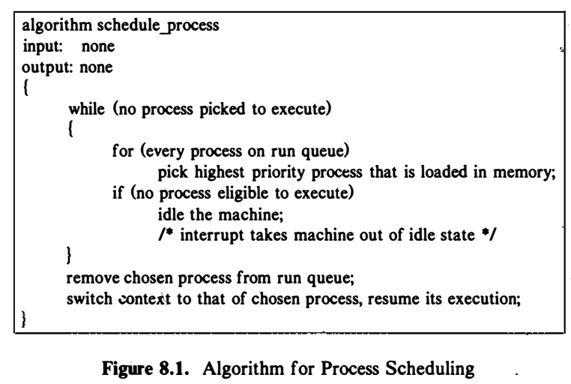
Process Scheduling

Slide 12
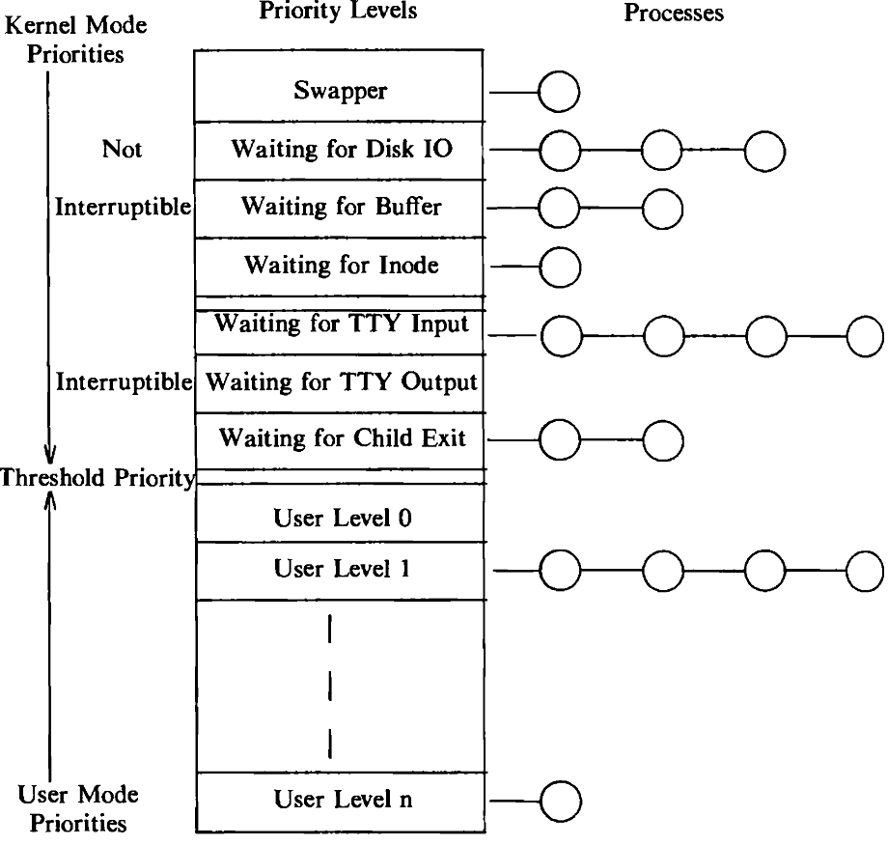
Process Scheduling
The range of process priorities can be partitioned into two classes:
User priorities and
Kernel priorities.
Fig: Range of Process Priorities

Slide 13
Process Scheduling
Each class contains several priority values, and each priority has a queue of processes.
User-level priorities are below a threshold value, and kernel-level priorities are above the threshold value.
Fig: Range of Process Priorities

Slide 14
Process Scheduling
The priorities called "swapper," "waiting for disk I/O," "waiting for buffer," and "waiting for mode" are high, non-interruptible system priorities.
Fig: Range of Process Priorities

Slide 15
Process Scheduling
The kernel calculates the priority of a process in specific process states.
I: Kernel assigns priority to a process about to go to sleep, correlating a fixed, priority value with the reason for sleeping.
Does not depends upon the run-time characteristics of a process.
Depends upon the reason of sleeping.
A process sleeping and waiting for the completion of disk I/O has a higher priority than a process waiting for a free buffer.

Slide 16
Process Scheduling
II: The kernel adjusts the priority of a process that returns from kernel mode to user mode.
The process may have previously entered the sleep state, changing its priority to a kernel-level priority that must be lowered to a user-level priority when returning to user mode.
Also, the kernel penalizes the executing process in fairness to other processes, since it had just used valuable kernel resources.

Slide 17
Process Scheduling
III: The clock handler adjusts the priorities of all processes in user mode at 1 second intervals and causes the kernel to go through the scheduling algorithm to prevent a process from monopolizing use of the CPU.
The clock may interrupt a process several times during its time quantum.
Once a second, the clock handler also adjusts the recent CPU usage of each process according to a decay function,
decay(CPU) = CPU/2

Slide 18
Process Scheduling
When clock handler recomputes recent CPU usage, the clock handler also recalculates the priority of every process in the "preempted but ready-to-run" state according to the formula:
Priority = ("recent CPU usage"/2) + (base level user priority)
The "base level user priority" is the threshold priority between kernel and user mode described above.
A numerically low value implies a high scheduling priority.

Slide 19
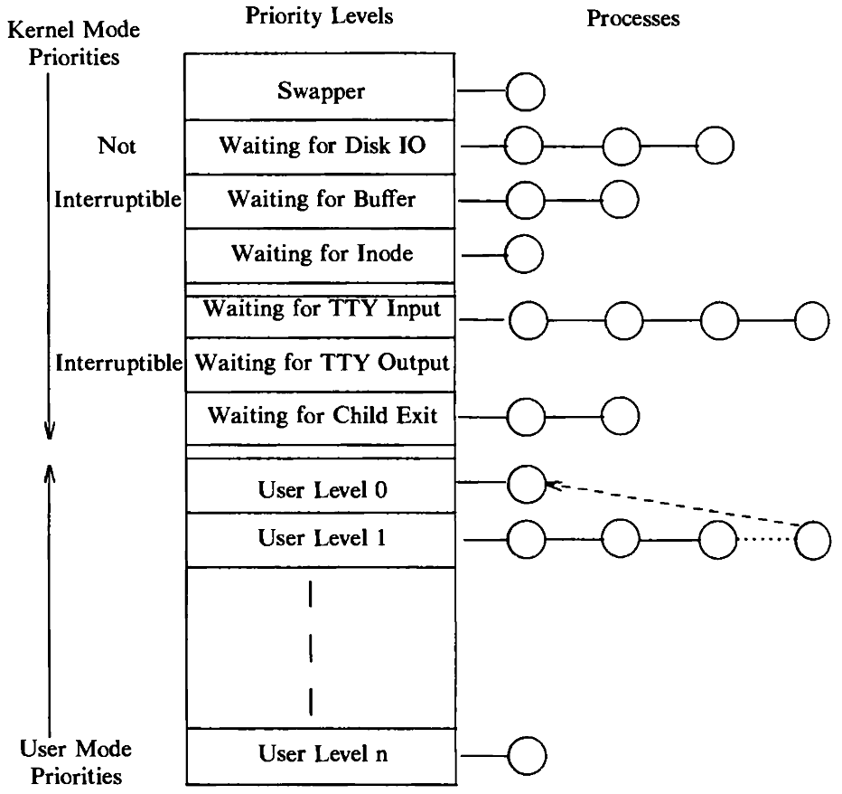
Process Scheduling
The recalculation of priority once a second.
The processes with user-level priorities move between priority queue on the bases of recalculated priority values.
All processes with user-level priorities would change priority queues but only one has been depicted.
Fig: Movement of a Process on Priority Queues

Slide 20
Process Scheduling
The kernel does not change the priority of processes in kernel mode.
The kernel does not allow processes with user-level priority to cross the threshold and attain kernel-level priority, unless they make a system call and go to sleep.

Slide 21
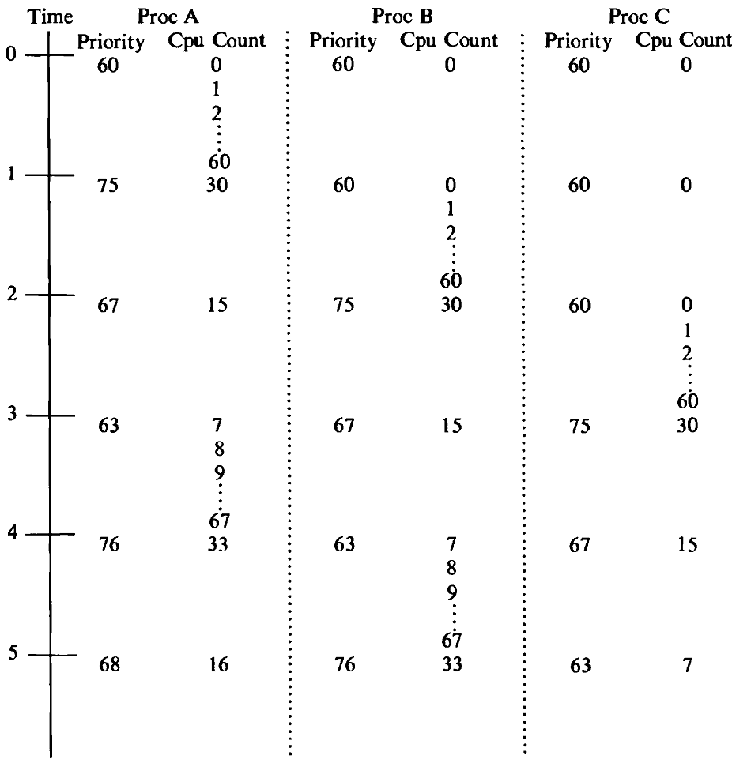
Example of Process Scheduling
We have 3 processes A, B, and C,
These all are created simultaneously with initial priority 60.
The clock interrupts the system 60 times a second.
The processes make no system calls, and no other processes are ready to run.
Fig: Example of Process Scheduling

Slide 22
Example of Process Scheduling
The kernel calculates the decay of the CPU usage by
CPU=Decay(CPU) = CPU/2;
The process priority as
Priority= CPU/2) + (base level user priority);
priority = (CPU/2) + 60;

Slide 23
Example of Process Scheduling
Assuming process A is the first to run and that it starts running at the beginning of a time quantum, it runs for 1 second.
During running time the clock interrupts the system 60 times and the interrupt handler increments the CPU usage field of process A to 60.
Fig: Example of Process Scheduling

Slide 24
Example of Process Scheduling
The kernel forces a context switch at the 1-second mark.
After recalculating the priorities of all processes, schedules process B for execution.
The clock handler increments the CPU usage field of process B to 60 during the next second.
Fig: Example of Process Scheduling

Slide 25
Example of Process Scheduling
Then recalculates the CPU usage and priority of all processes and forces a context switch.
Priority?
Fig: Example of Process Scheduling

Slide 26
Example of Process Scheduling
Then recalculates the CPU usage and priority of all processes and forces a context switch.
Priority?
Fig: Example of Process Scheduling

Slide 27
Example of Process Scheduling
Then recalculates the CPU usage and priority of all processes and forces a context switch.
Priority?
Fig: Example of Process Scheduling

Slide 28
Example of Process Scheduling
Then recalculates the CPU usage and priority of all processes and forces a context switch.
Priority?
Fig: Example of Process Scheduling

Slide 29
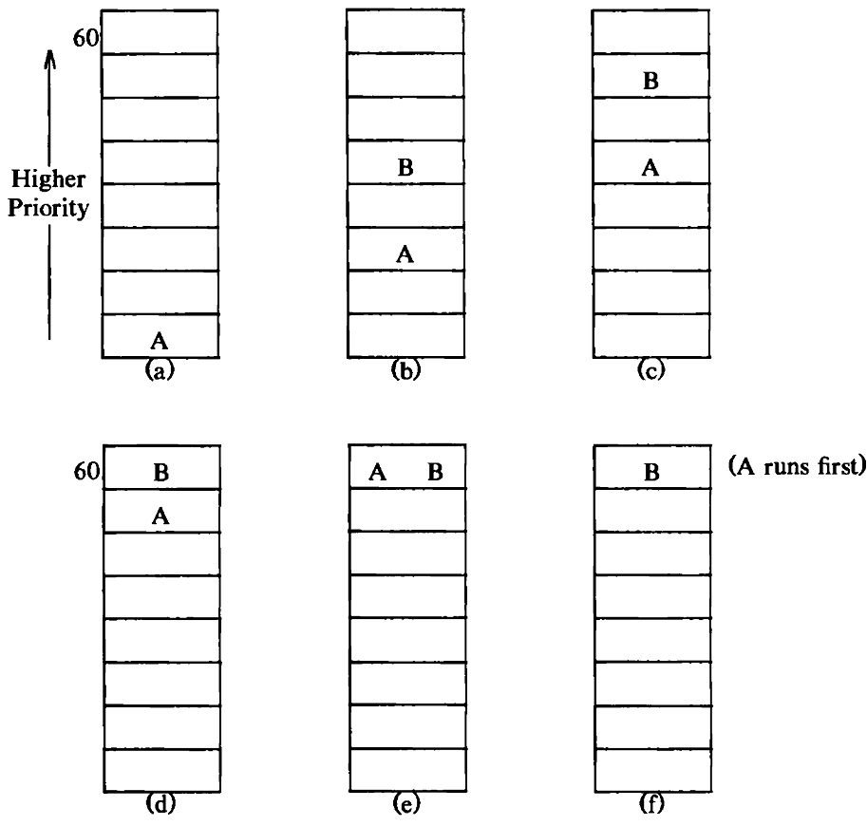
Process Priorities
The kernel may preempt process A, leaving it in the state "ready to run,".
As time progresses, process B may enter the "ready-to-run" state, and its user-level priority may be higher than that of process A at that instant .
Fig: Round Robin Scheduling and Process Priorities

Slide 30
Process Priorities
If kernel does not schedule either process (A and B)
Both processes will be at same priority level.
Fig: Round Robin Scheduling and Process Priorities

Slide 31
Process Priorities
The tie in both of the processes.
“A” run ahead of process “B” because it was in the state "ready to run" for a longer time.
This is the tie-breaker rule for processes with equal priority.
Fig: Round Robin Scheduling and Process Priorities

Slide 32
Problem statement
Find out process scheduling of 3 processes A, B, and C,
These all are created simultaneously with initial priority 60, 70, 65 respectively.
The clock interrupts the system 60 times a second.
The processes make no system calls, and no other processes are ready to run.
Threshold is 60

Slide 33
Controlling Process Priorities
Processes scheduling priority by using the nice system call.
Processes inherit the nice value of their parent during the fork system call.
The nice system call increments or decrements the nice field in the process table by the value of the parameter.
nice (value);
where value is added in the calculation of process priority:
priority= ("recent CPU usage"/2) + (base priority) + (nice value)

Slide 34
Controlling Process Priorities
Processes inherit the nice value of their parent during the fork system call
The nice system call works for the running process only
A process cannot reset the nice value of another process
Only the superuser can supply a nice value below a particular threshold.

Slide 35
Fair Share Scheduler
Divide the processes into a set of fair share groups.
The system allocates CPU time proportionally to each group, regardless of how many processes are in the groups.
The scheduler algorithm described earlier does not differentiate between classes of users.

Slide 36
Fair Share Scheduler
An another term is added to the formula for computation of process priority, fair share group priority.
Each process has a new field that points to a fair share CPU usage field, shared by all processes in the fair share group.
The clock interrupt handler increments the fair share group CPU usage field for the running process, just as it increments the CPU usage field of the running process.

Slide 37
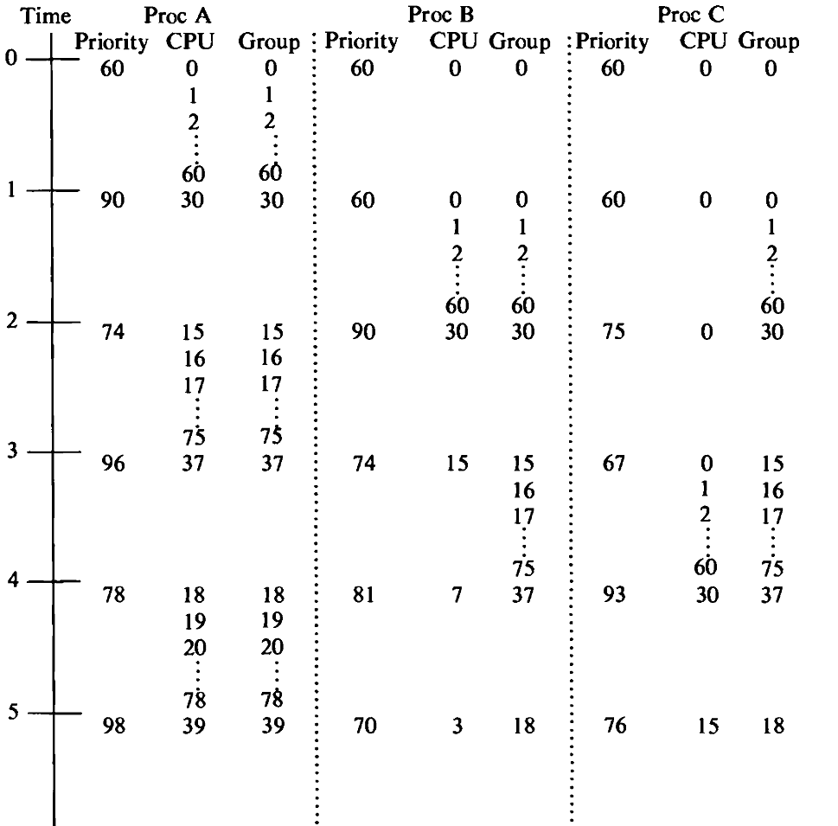
Fair Share Scheduler
The example, considers the three processes (A,B,C) and suppose that process A is in one group and processes B and C are in another.
Assuming the kernel schedules process A first, it will increment the CPU and group usage fields for process A over the next second.
Fig: Example of Fair Share Scheduler

Slide 38
Fair Share Scheduler
On recomputation of process priorities at the 1-second mark, processes B and C have the highest priority; assume the kernel schedules process B.
During the next second, the CPU usage field of process B goes up to 60, as does the group usage field for processes B and C.
Fig: Example of Fair Share Scheduler

Slide 39
Fair Share Scheduler
On recomputation of process priorities at the 2-second mark, process C will have priority 75, and the kernel will schedule process A, with priority 74.
The Fig. Shows that the kernel schedules the processes in the order A, B, A, C, A, B, and so on.
Fig: Example of Fair Share Scheduler

Slide 40
Real-Time Processing
Real-time processing implies the capability to provide immediate response to specific external events and, hence, to schedule particular processes to run within a specified time limit after occurrence of an event.
It is desirable that response to the user be quick.
A true solution to the problem must allow real-time processes to exist dynamically, providing them with a mechanism to inform the kernel of their real-time constraints.
No standard UNIX system has this capability today.

Slide 41
System Calls for Time
There are several time-related system calls, stime, time, times, and alarm.
Global system time: stime and time
#include <time.h>
Deal with time for individual processes: times, and alarm.
stime allows to set a global kernel variable .
int stime (pvalue);
where pvalue points to a long integer that gives the time as measured in seconds from midnight (00:00:00) January 1, 1970, GMT.
On success, zero is returned. On error, -1 is returned.

Slide 42
System Calls for Time
Time retrieves the time, measured in seconds (GMT).
time(tloc*);
tloc points to a location in the user process for storing the return value.
Several routines are available to convert the long integer returned by time() into an ASCII date string. With the UNIX operating system, an ASCII date string is a string as shown below:
Day Mon dd hh:mm:ss yyyy
eg. char* ctime()

Slide 43
System Calls for Time
Times retrieves the cumulative times that the calling process spent executing in user mode and kernel mode.
times(tbuffer*);
struct tms *tbuffer;
where the structure tms contains the retrieved times and is defined by
struct tms {
// time_t is the data structure for time
time_t tms_utime; // user time of process
time_t tm_stime; // kernel time of process
time_t tms_cutime; // user time of children
time_t tms_cstime; // kernel time of children
};

Slide 44
System Calls for Time
Times returns the elapsed time "from an arbitrary point in the past," usually the time of system boot.
Times() is defined in <sys/times.h>

Slide 45
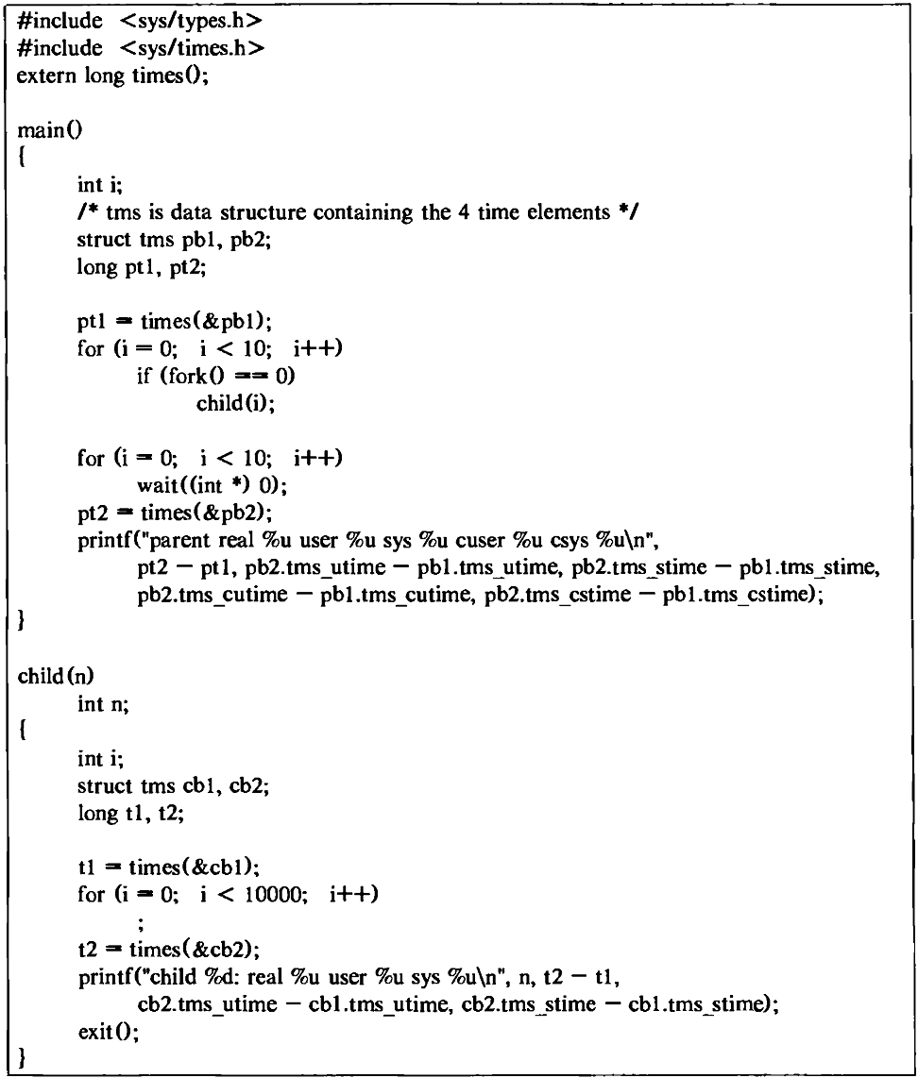
Fig: Program Using Times

Slide 46
System Calls for Time
Alarm system call sets the alarm clock of a process.
User processes can schedule alarm signals using the alarm system call.
int alarm(int sec);
The alarm function causes the system to generate a SIGALRM signal for the process after the number of real-time seconds specified by sec (seconds)
If there is a previous alarm() request with time remaining, alarm() returns a non-zero value that is the number of seconds until the previous request would have generated a SIGALRM signal. Otherwise, alarm() returns 0.
alarm() is defined in <#include <unistd.h>

Slide 47
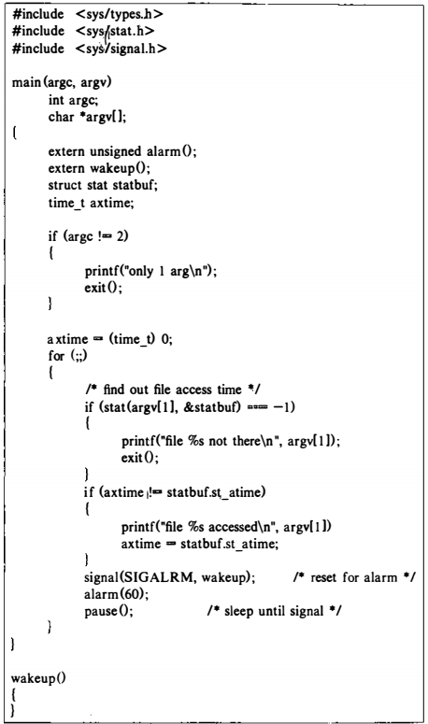
System Calls for Time: alarm

Slide 48
System Calls for Time
for (;;) {
signal (SIGALRM, wakeup) ; // reset for alarm
alarm (60) ;
pause () ; } //sleep until signal
The process calls signal to catch alarm signals.
Then process calls alarm to schedule an alarm signal in 60 seconds,
Then process calls pause to suspend its activity until receipt of a signal.
After 60 seconds, the alarm signal goes off, the kernel calls the signal catcher function, then process executes the loop again.
All the time related system calls are reliance on the system clock.

Slide 49
Clock
The functions of the clock interrupt handler are to
Restart the clock,
Schedule invocation of internal kernel functions based on internal timers,
Provide execution profiling capability for the kernel and for user processes,
Gather system and process accounting statistics
Keep track of time,
Send alarm signals to processes on request,
Some operations are done every clock interrupt, whereas others are done after several clock ticks.

Slide 50
Restarting the Clock
When the clock interrupts the system, most machines require that the clock be re-primed by software instructions so that it will interrupt the processor again after a suitable interval.
Such instructions are hardware dependent

Slide 51
Internal System Timeouts
Some kernel operations require invocation of kernel functions on a real-time basis
like, device drivers and network protocols,.
Callout table
Stores time related necessary information
Functions to be invoked when time expires,
Parameter for the function
the time in clock ticks until the function should be called.
The kernel sorts entries in the callout table according to their respective time to fire.

Slide 52
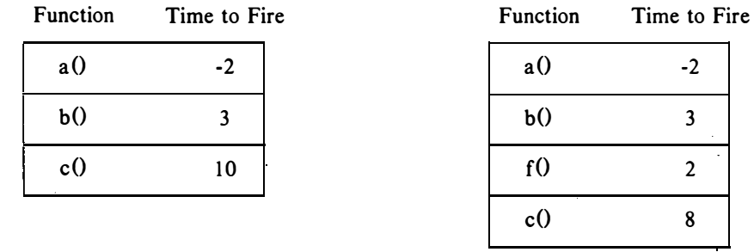
Internal System Timeouts
Time ordering, the time field for each entry in the callout table is stored as the amount of time to fire after the previous element fires.
The total time to fire for a given element in the table is the sum of the times to fire of all entries up to and including the element.
Fig: Callout Table and New Entry for function f

Slide 53
Internal System Timeouts
Fig. shows the callout table before and after addition of a new entry for the function f().
When making a new entry, the kernel finds the correct (timed) position for the new entry and appropriately adjusts the time field of the entry immediately after the new entry.
Before
After
Fig: Callout Table and New Entry for function f

Slide 54
Internal System Timeouts
Kernel arranges to invoke function f() after 5 clock ticks: it creates an entry for f() after the entry for b() with the value of its time field 2.
Changes the time field for c() to 8 (c will still fire in 13 clock ticks).
Before
After
Fig: Callout Table and New Entry for function f

Slide 55
Internal System Timeouts
At every clock interrupt, the clock handler checks if there are any entries in the callout table.
At the same time, clock handler decrements the time field of the first entry.
Decrementing the first entry effectively decrements the time field for all entries in the table.
Before
After
Fig: Callout Table and New Entry for function f

Slide 56
Internal System Timeouts
If the time field of the first entry in the list is less than or equal to 0, then the specified function should be invoked.
Before
After
Fig: Callout Table and New Entry for function f

Slide 57
Internal System Timeouts
The clock handler schedules the function by causing a "software interrupt," sometimes called a "programmed interrupt".
Because software interrupts are at a lower priority level than other interrupts, they are blocked until the kernel finishes handling all other interrupts.
Before
After
Fig: Callout Table and New Entry for function f

Slide 58
Internal System Timeouts
Many interrupts, including clock interrupts, could occur between the time the kernel is ready to call a function in the callout table and the time the software interrupt occurs and, therefore, the time field of the first callout entry can have a negative value.
Before
After
Fig: Callout Table and New Entry for function f

Slide 59
Internal System Timeouts
When the software interrupt finally happens, the interrupt handler removes entries from the callout table whose time fields have expired and calls the appropriate function.
The time field of the entry for function a() is -2, meaning that the system took 2 clock interrupts after a() was eligible to be called.
Assuming the entry for b() was in the table 2 ticks ago, the kernel skipped the entry for a() and decremented the time field for b().

Slide 60
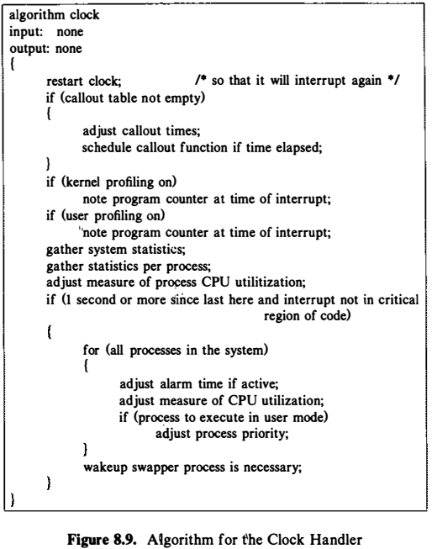
Algorithm: Clock Handler

Slide 61
Profiling
Kernel profiling gives
A measure of how much time the system is executing in user mode versus kernel mode, and
How much time it spends executing individual routines in the kernel.
The kernel profile driver
Monitors the relative performance of kernel modules by sampling system activity at the time of a clock interrupt.
Has a list of kernel addresses to sample, usually addresses of kernel functions.

Slide 62
Profiling
If kernel profiling is enabled, the clock interrupt handler invokes the interrupt handler of the profile driver, which determines whether the processor mode at the time of the interrupt was user or kernel.
If the mode was user, the profiler increments a count for user execution, but if the mode was kernel, it increments an internal counter corresponding to the program counter.

Slide 63
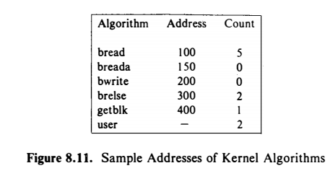
Profiling
For example, Figure 8.11 shows hypothetical addresses of several kernel routines.
If the sequence of program counter values sampled over 10 clock interrupts is:
110, 330, 145, address in user space, 125, 440, 130, 320, address in user space, and 104, the figure shows the counts the kernel would save.
Examining these figures, one would conclude that the system spends 20% of its time in user mode and 50% of its time executing the kernel algorithm bread.

Slide 64
Profiling
Profile execution of processes at user-level with the profil system call:
profil (buff, bufsize, offset, scale)
where buff is the address of an array in user space,
bufsize is the size of the array,
offset is the starting address in the process that is to be profiled, i.e. virtual address of a user subroutine (usually, the first) , and
scale is a factor that maps user virtual addresses into the array.
In user mode, the clock handler examines the user program counter at the time of the interrupt, compares it to offset, and increments a location in buff whose address is a function of bufsize and scale.

Slide 65
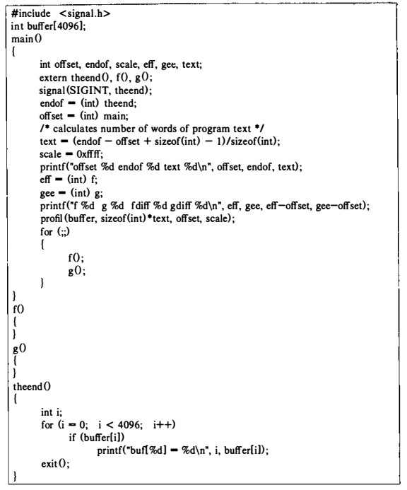

Slide 66
Accounting and Statistics
Every process has two fields in its u area
To keep a record of elapsed kernel and
user time.
When handling clock interrupts, the kernel updates the appropriate field for the executing process, depending on whether the process was executing in kernel mode or in user mode.
Parent processes gather statistics for their child processes in the wait system call when accumulating execution statistics for exiting child processes.

Slide 67
Accounting and Statistics
Every process has one field in its u area for the kernel
to log its memory usage
When the clock interrupts a running process, the kernel calculates the total memory used by a process as a function of its private memory regions and its proportional usage of shared memory regions.
For example,
if a process shares a text region of size 50K bytes with four other processes and uses data and stack regions of size 25K and 40K bytes, respectively,
The kernel charges the process for 75K bytes (50K/5 + 25K + 40K) .

Slide 68
Summary (Process Scheduling and Time)
The kernel associates a scheduling priority with every process in the system.
The priority assigned in the clock handler depends on how much time the process has recently used the CPU.
The nice system call allows a process to adjust one parameter used in computation of process priority.
Then system calls dealing with time: setting and retrieving kernel time, retrieving process execution times, and setting process alarm signals.
The functions of the clock interrupt handler, which keeps track of system time, manages the callout table, gathers statistics.

Slide 69
Reference
The Design of the UNIX Operating System, by Maurice J. Bach

